Slide 1


Slide 2
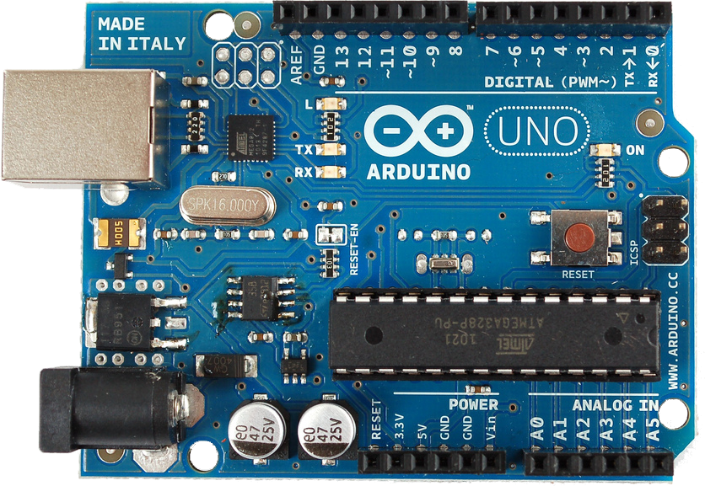
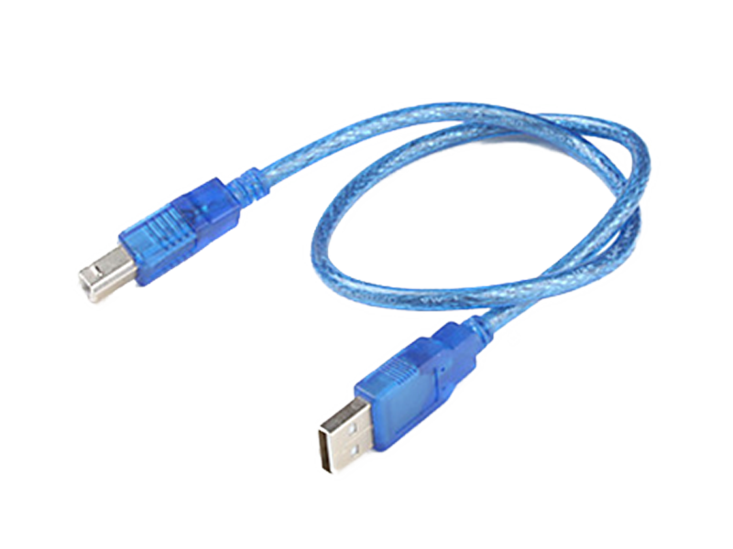
Arduino Uno (Mikrokontroler) + Kabel USB

Slide 3
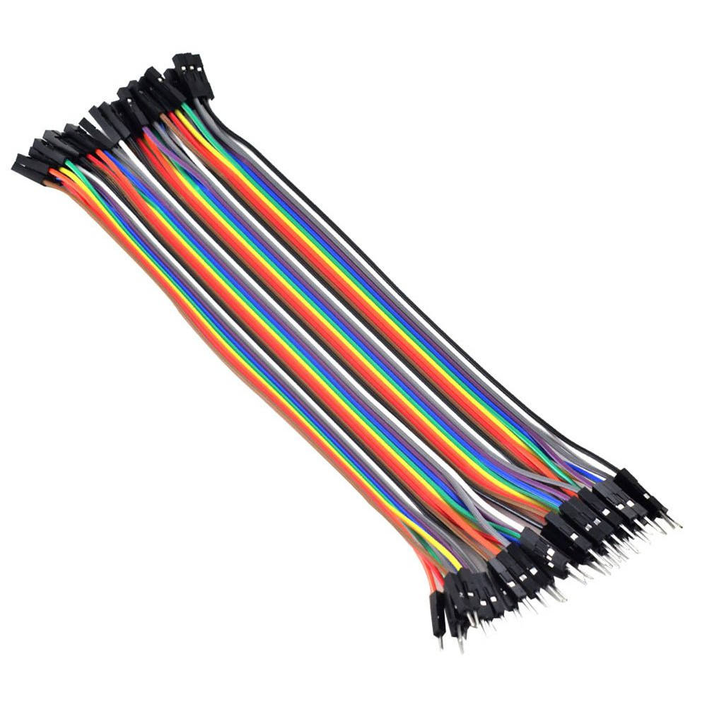
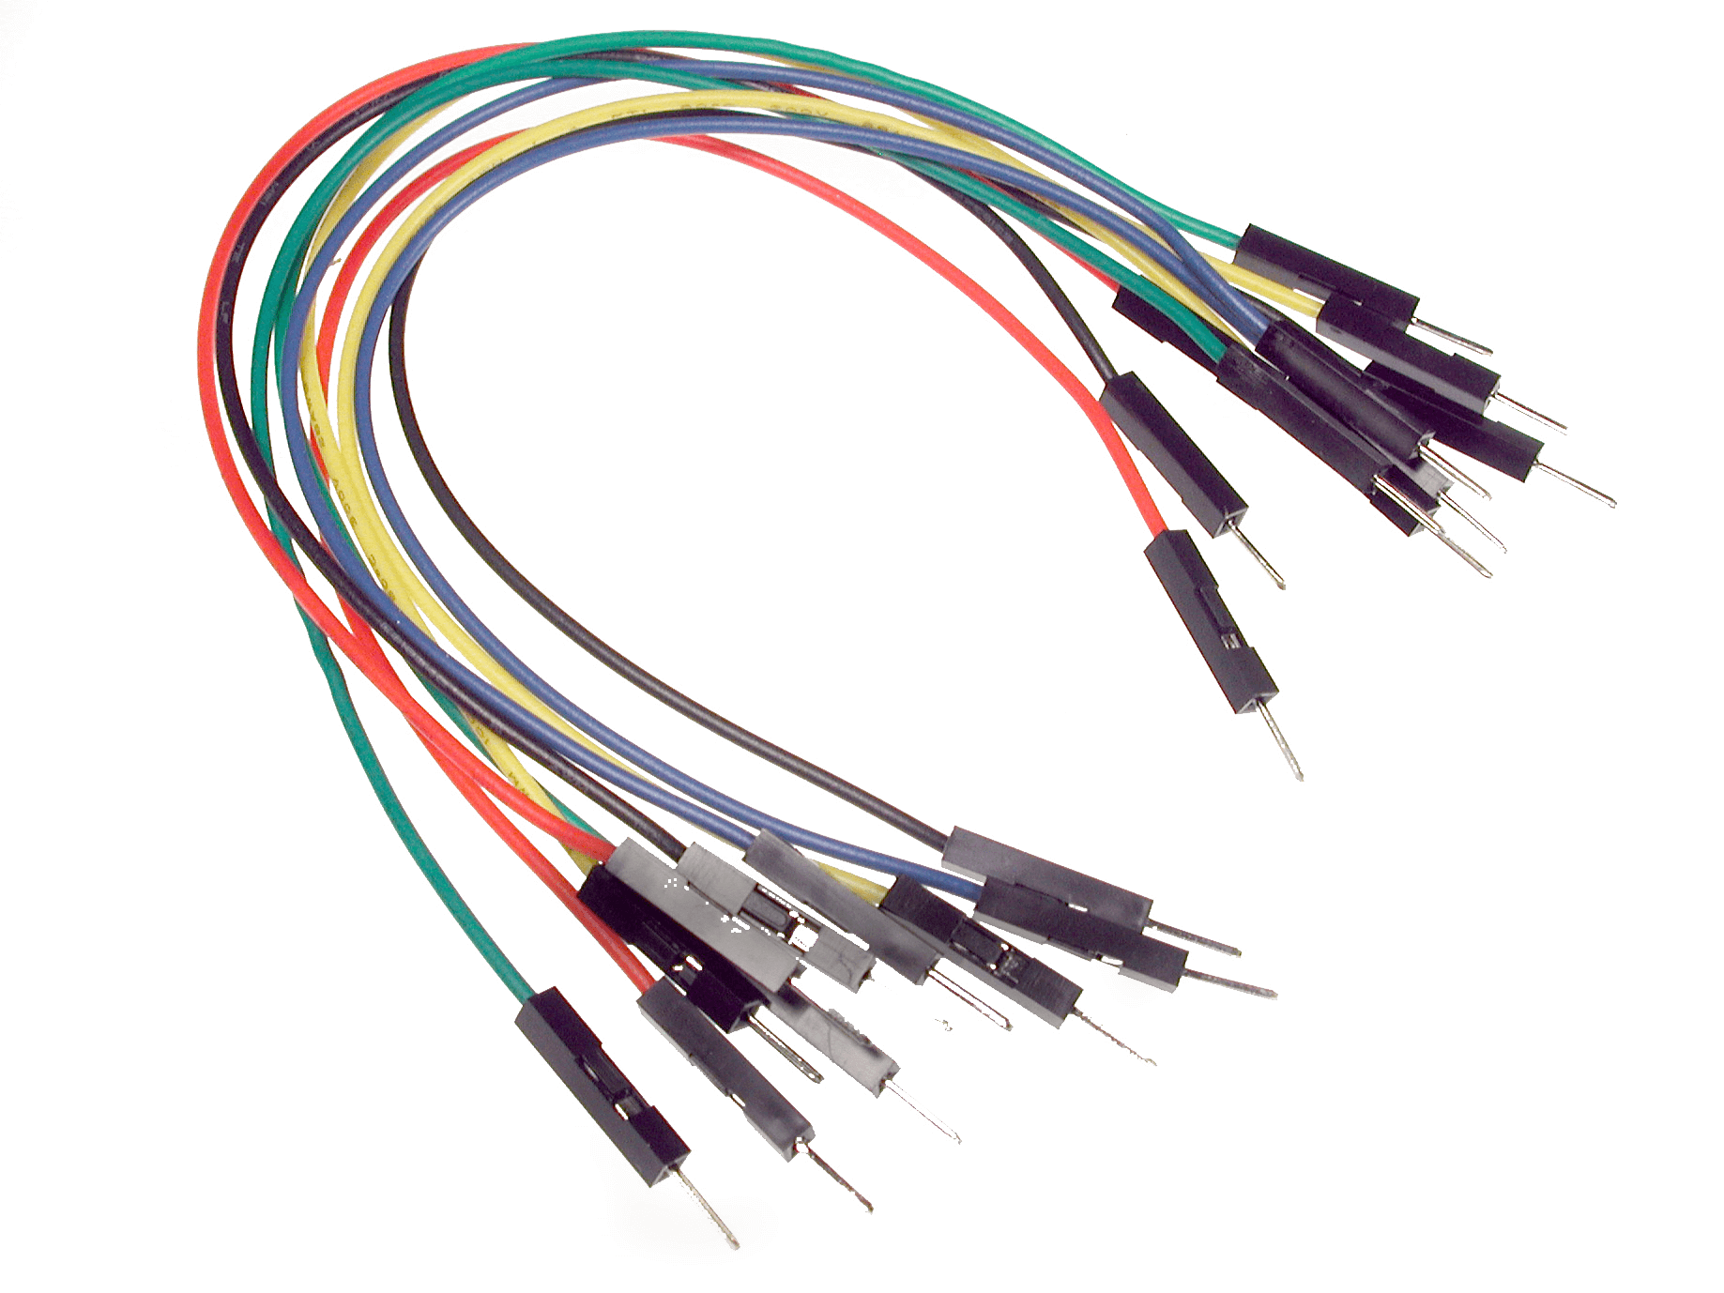
Kabel Jumper Male-Male dan Male-Female

Slide 4
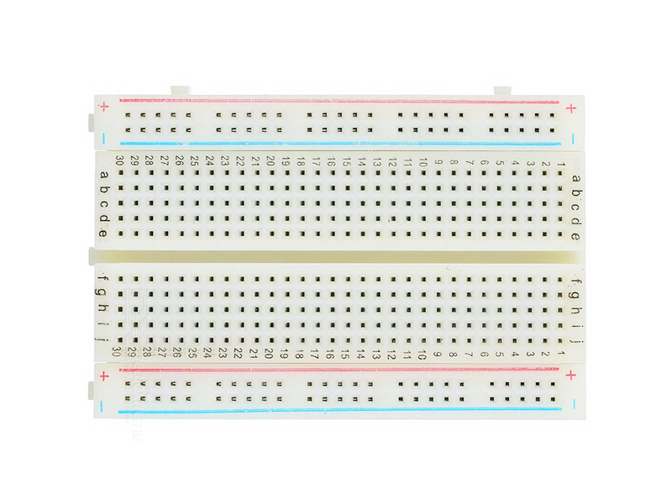
Breadboard
Bagian Atas
Keterangan:
Seri
Paralel
Bagian Tengah
Bagian Bawah

Slide 5
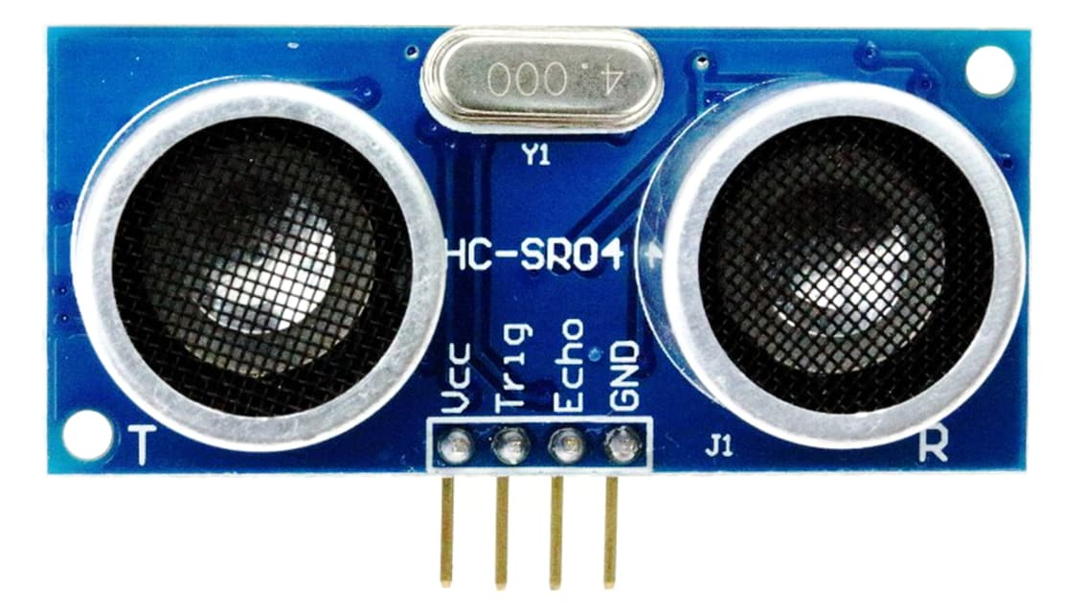
Sensor Ultrasonik (Jarak) HC-SR04

Slide 6
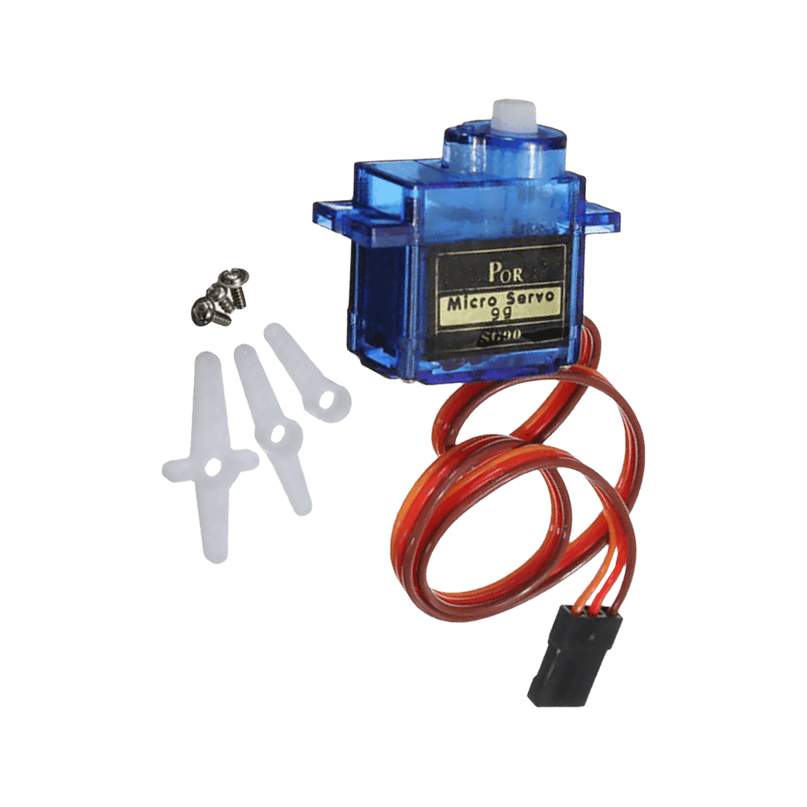
Servo 180°

Slide 7
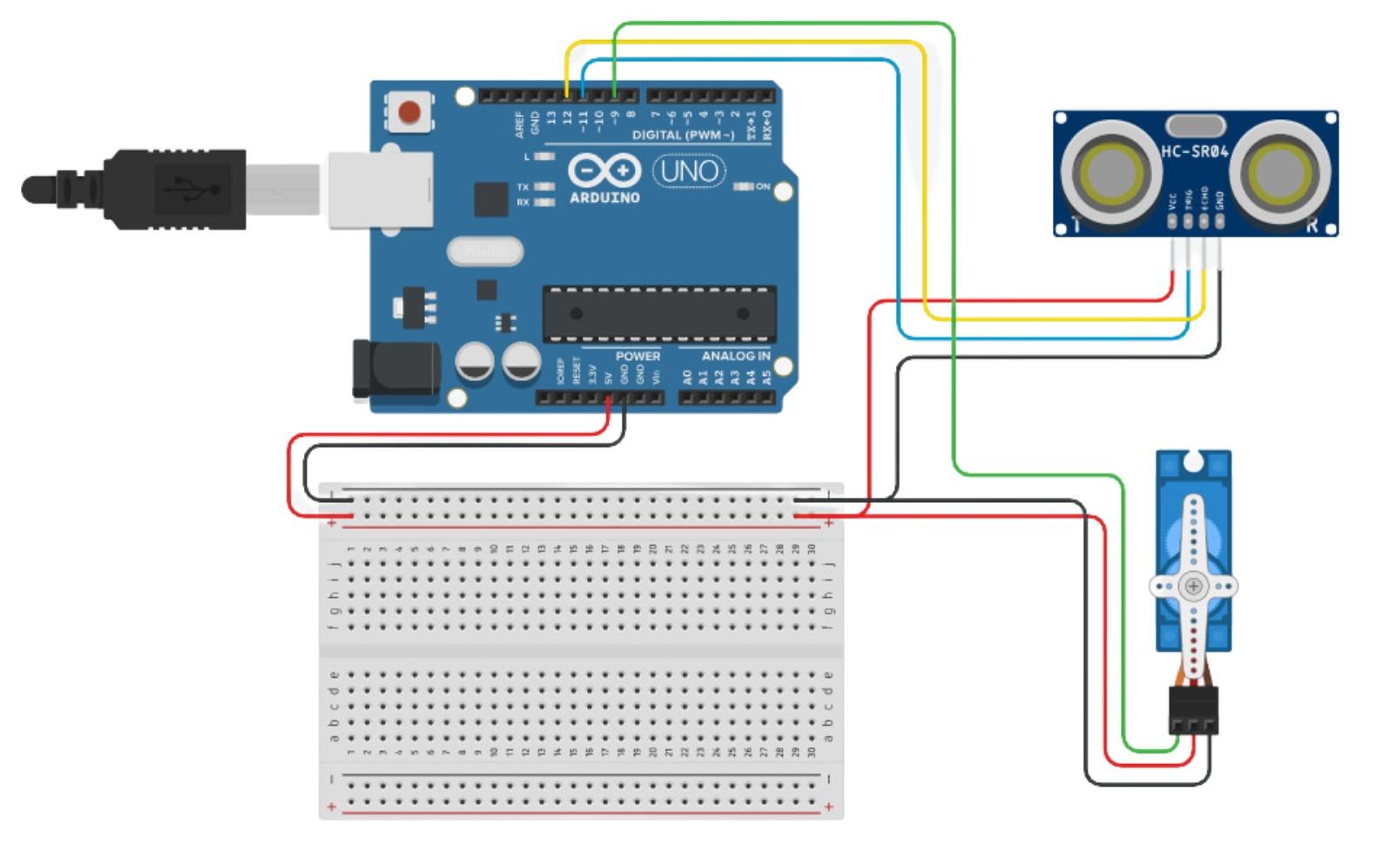
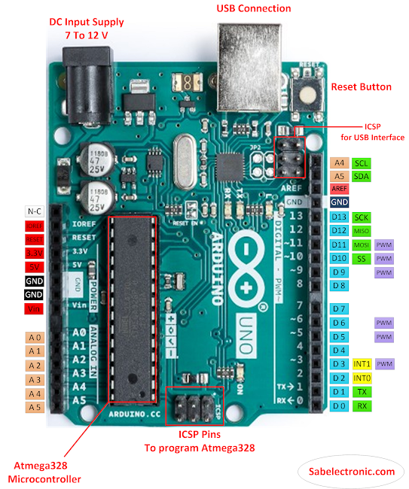
Wiring Diagram
Arduino Uno GPIO | Ultrasonik HC-SR04 | Servo 180°
9 |  | Signal
11 | TRIG
12 | ECHO
GND | GND | GND
5V | 5V | 5V
Arduino UNO
Ultrasonik HC-SR04
Servo 180°
BreadBoard

Slide 8


